Slide 1

Natural Language Processing
GROUP 1(Vijaya, Pavana, Yeswanth, Vrunda, Sakshi, Sarah, Yashodha)
Varun & Anavadhya
18/05/23

Slide 2
BUSINESS OBJECTIVE
Inappropriate emails would demotivate and spoil the positive environment that would lead to more attrition rate and low productivity.
Inappropriate emails could be on form of bullying, racism, sexual favourtism and hate in the gender or culture, in today’s world so dominated by email no organization is immune to these hate emails.
The goal of the project is to identify such emails in the given day based on the above inappropriate content.

Slide 3
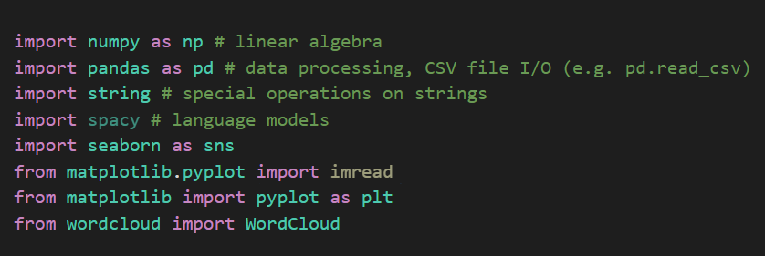
UNDERSTANDING THE DATASET
For NLP, various packages like nltk, wordcloud, spacy, genism, textblob, textstat, etc. have been installed using !pip install code.
Then imported those libraries and the dataset
Importing the required libraries. Importing the dataset using the pandas library and declared as a def function. Exploring the data by .info(), .describe(), finding out the nan values in the dataset.
The dataset contains around 20 lakh emails generated by employees of an organization.

Slide 4
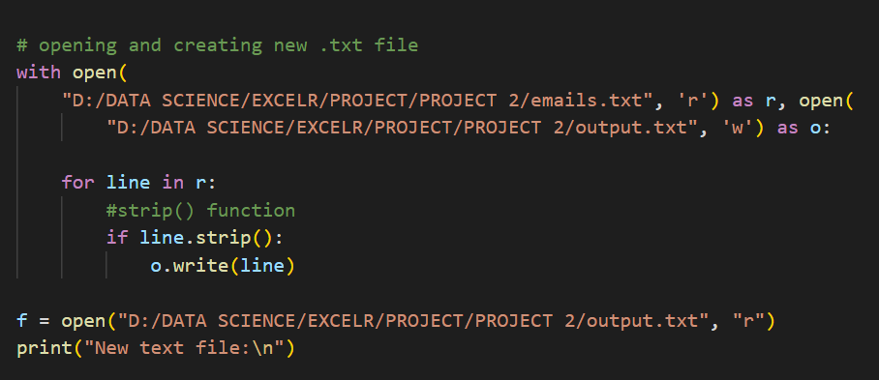
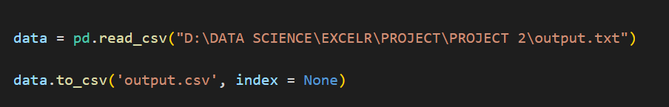
As the dataset has empty rows, the strip() function has been used to remove that and a new .txt file has been generated.
Importing the dataset

Slide 5
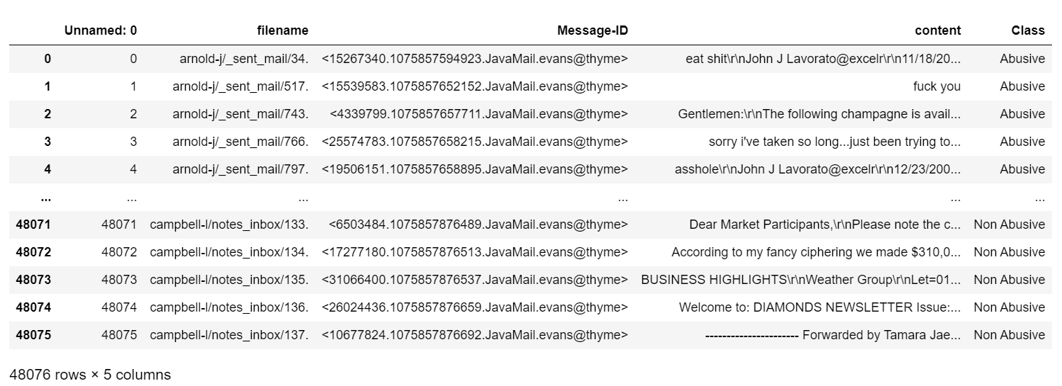
The dataset has 5 columns out of which only 2 are required, i.e. (Content and Class)
Dropped the irrelevant columns from the dataset.

Slide 6
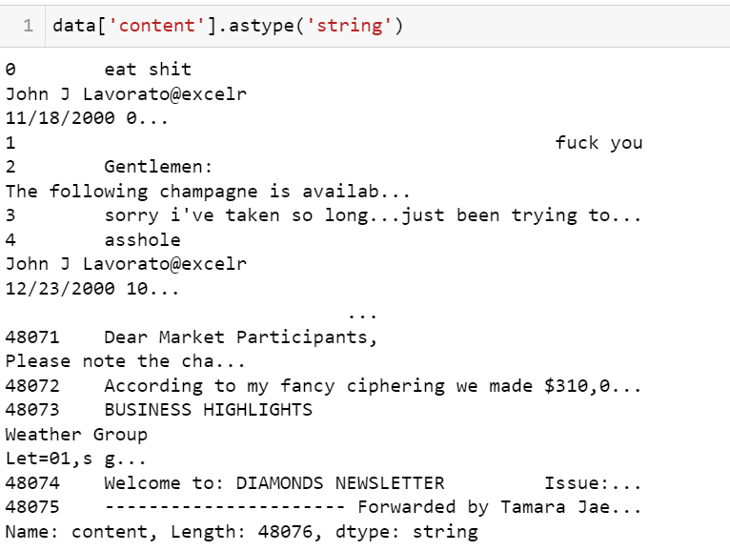
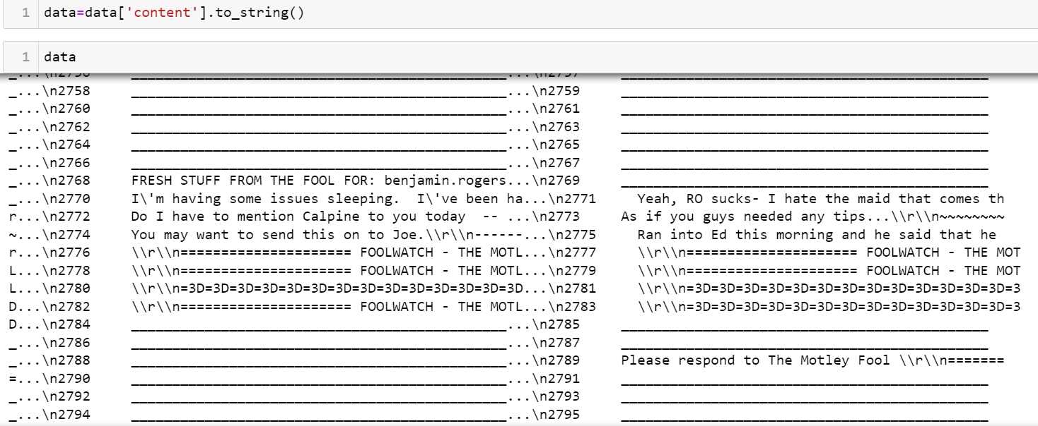
As the datatype of the content column is object, need to convert it to string to replace the special characters.

Slide 7
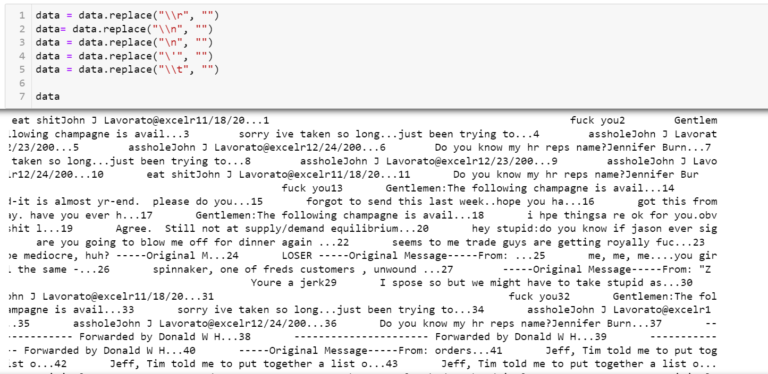
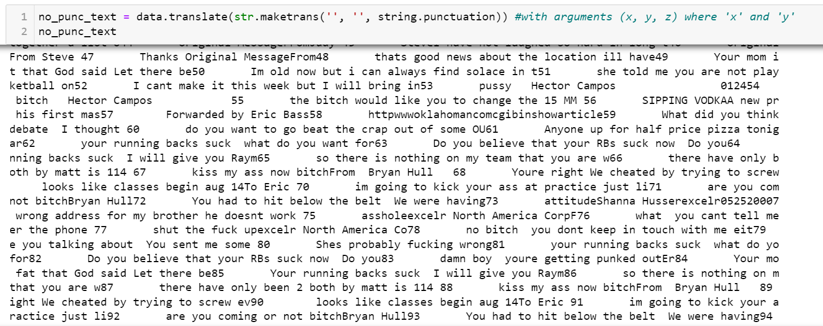
After removing the special characters
Removing extra punctuation marks

Slide 8
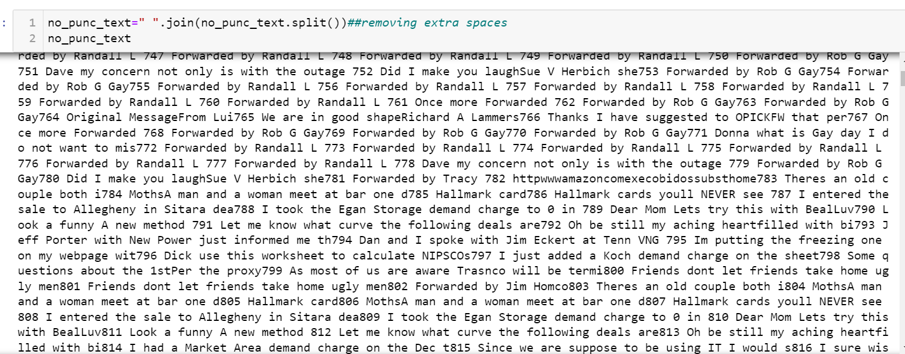
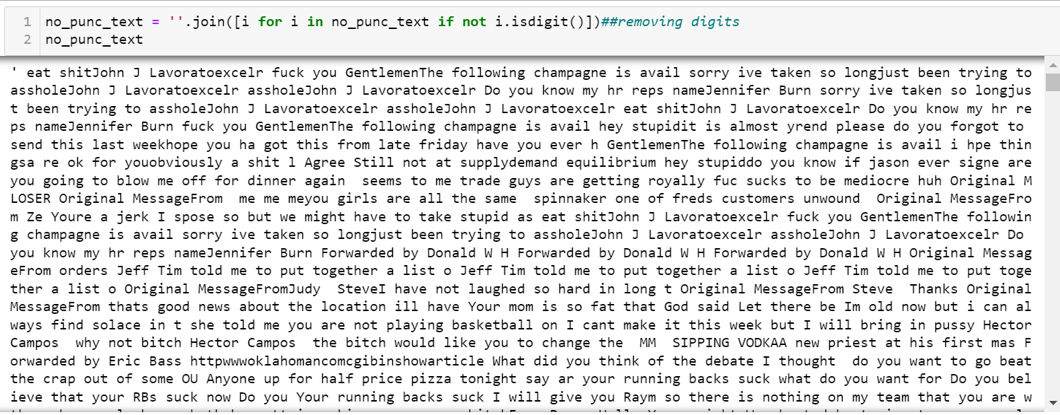
Removal of extra spaces
Removing the digits

Slide 9
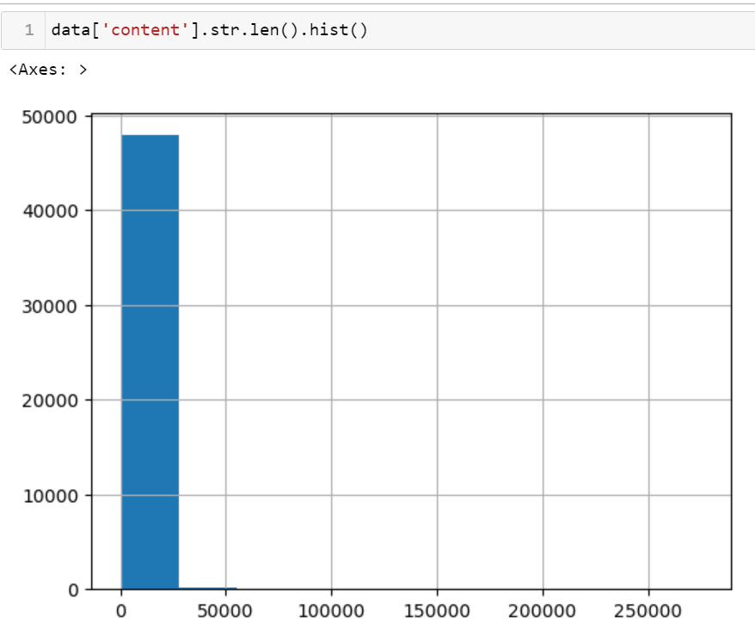
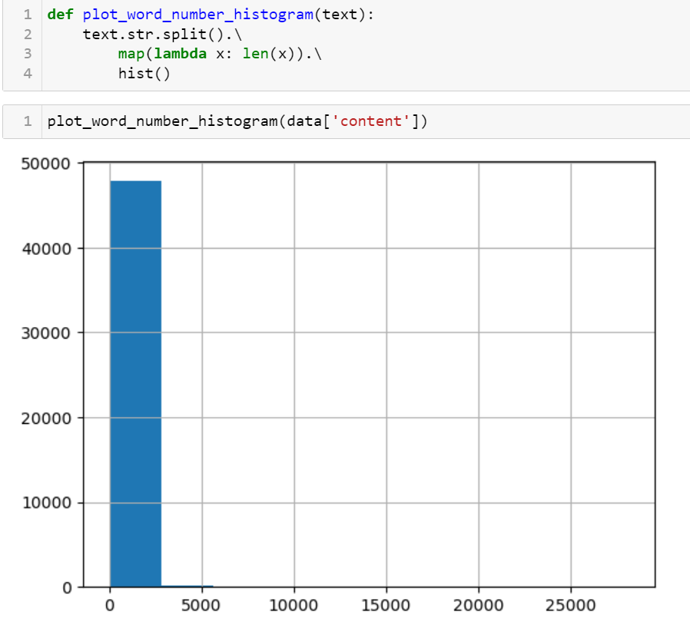
VISUALIZATIONS

Slide 10
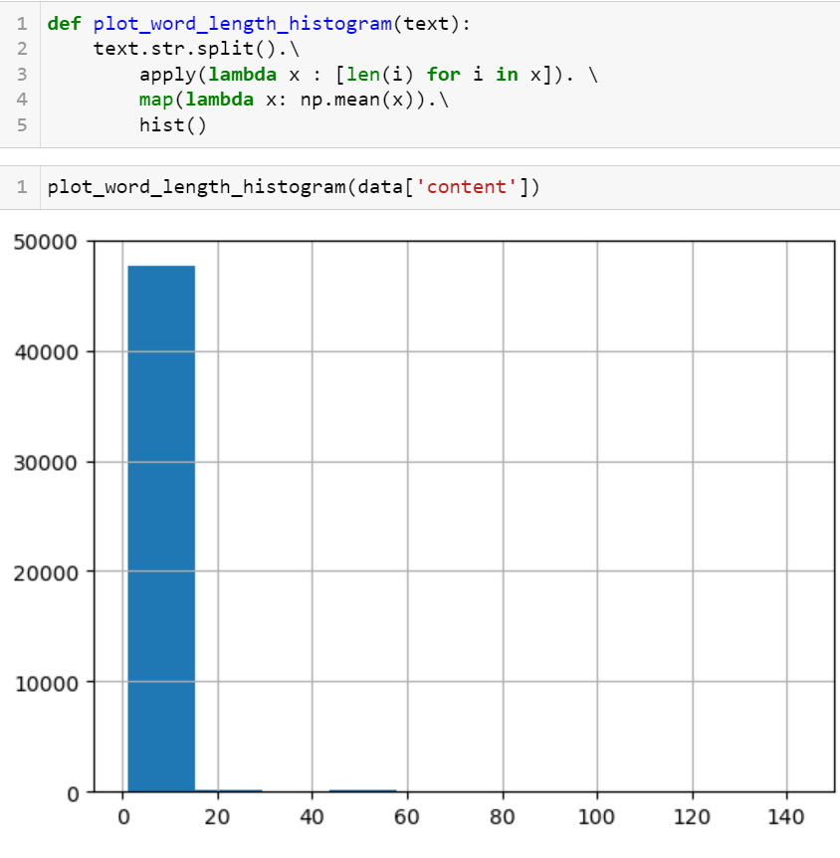
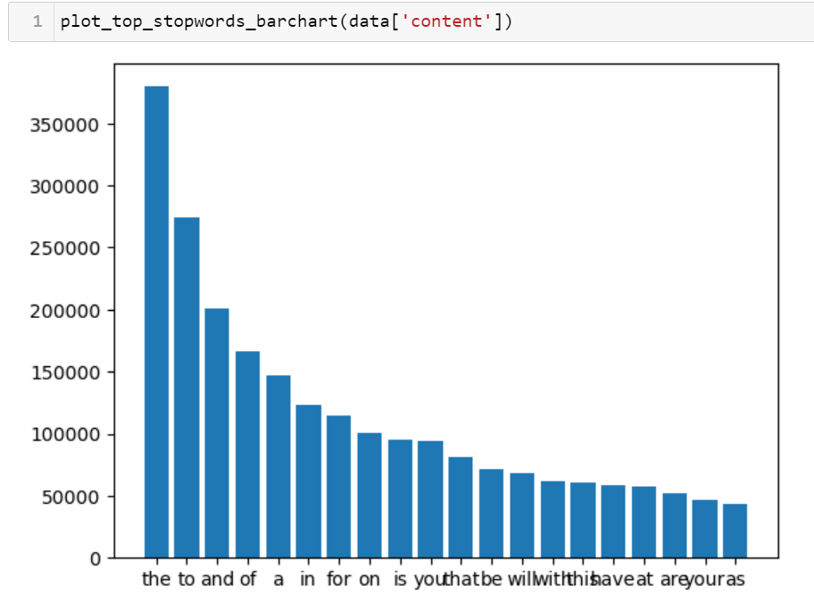

Slide 11
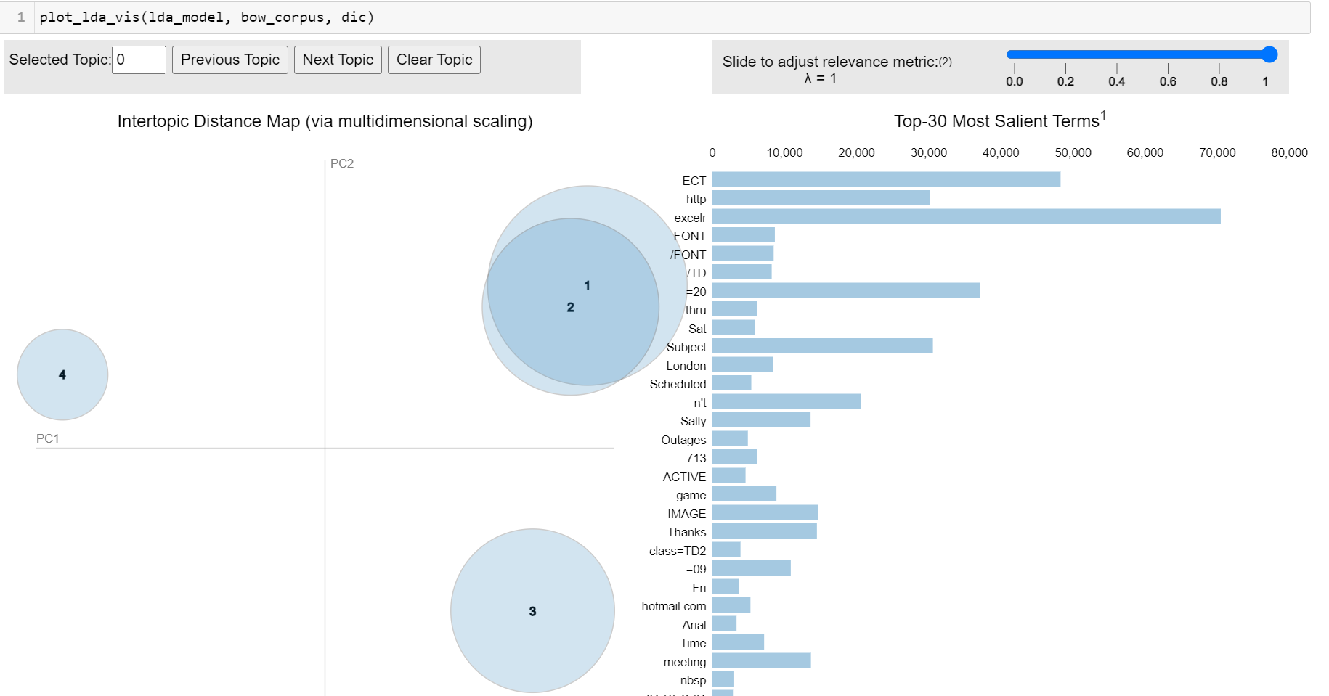
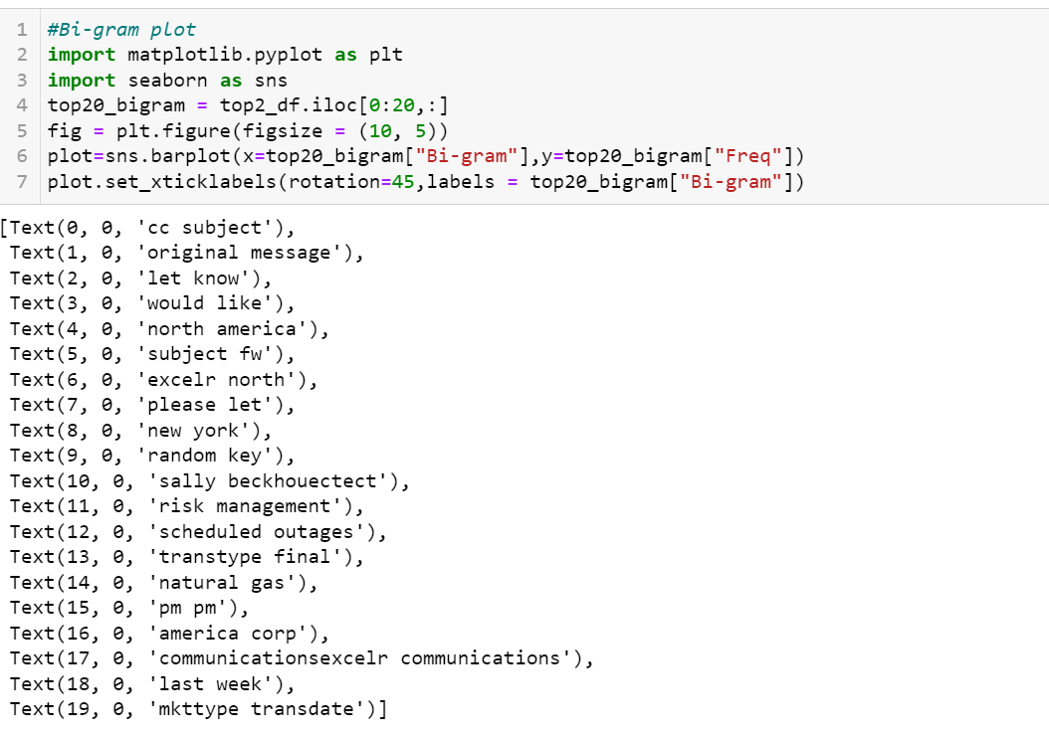
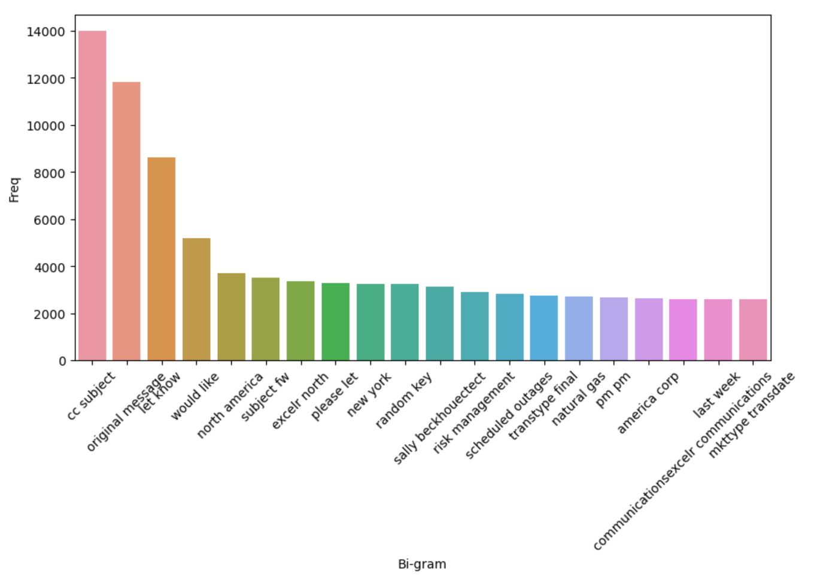
LDA basically the statistical model that explains a set of observations through unobserved groups and each group explains why some parts of the data are similar
BI-GRAMS

Slide 12
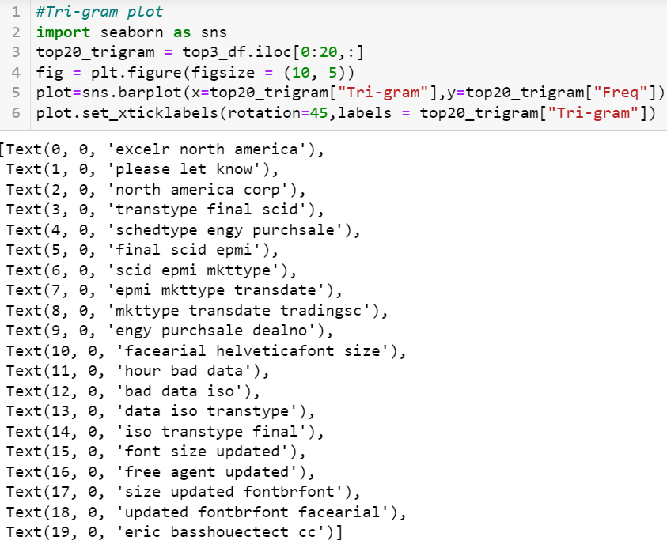
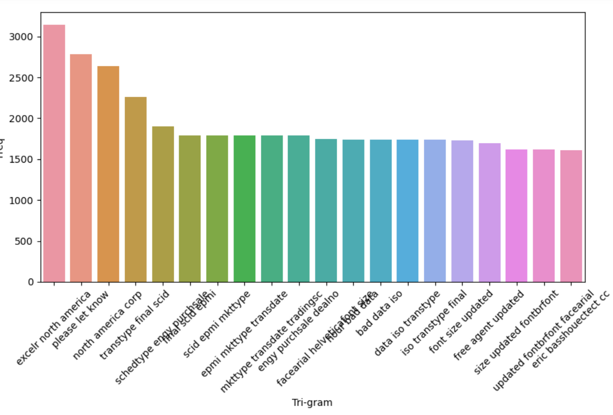
TRI-GRAM

Slide 13
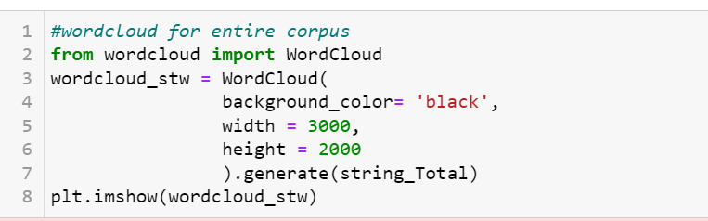
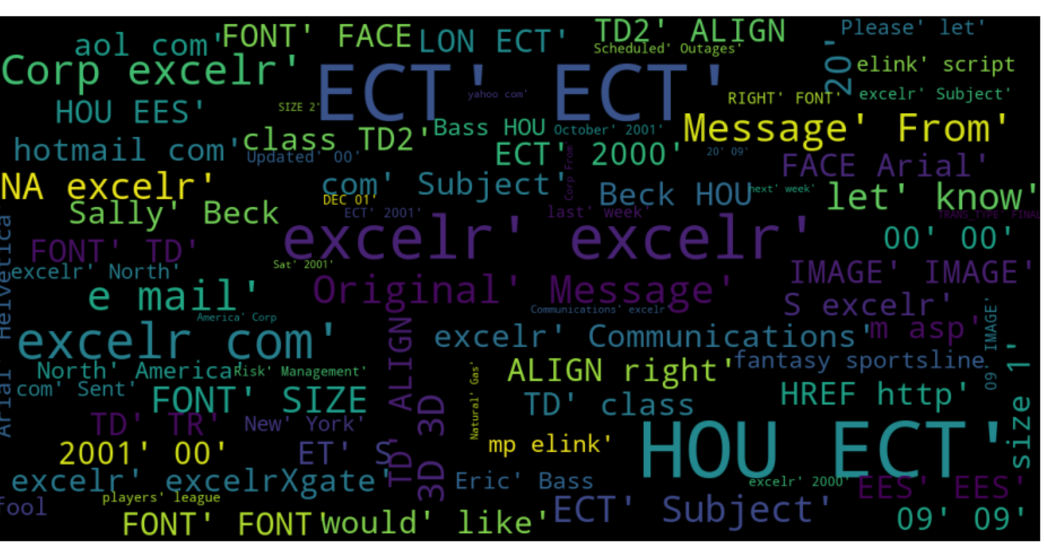
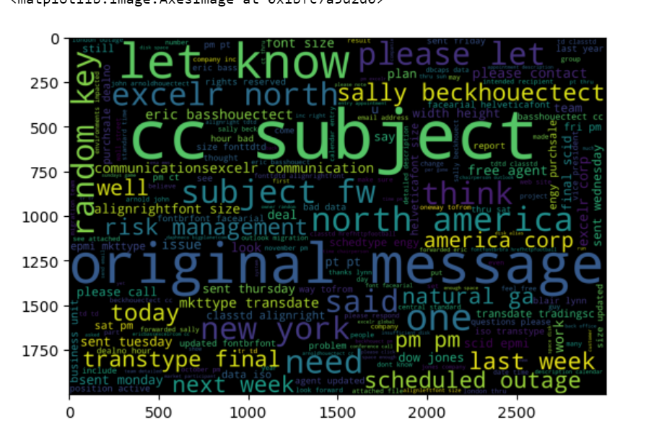

Slide 14
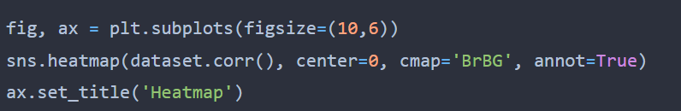
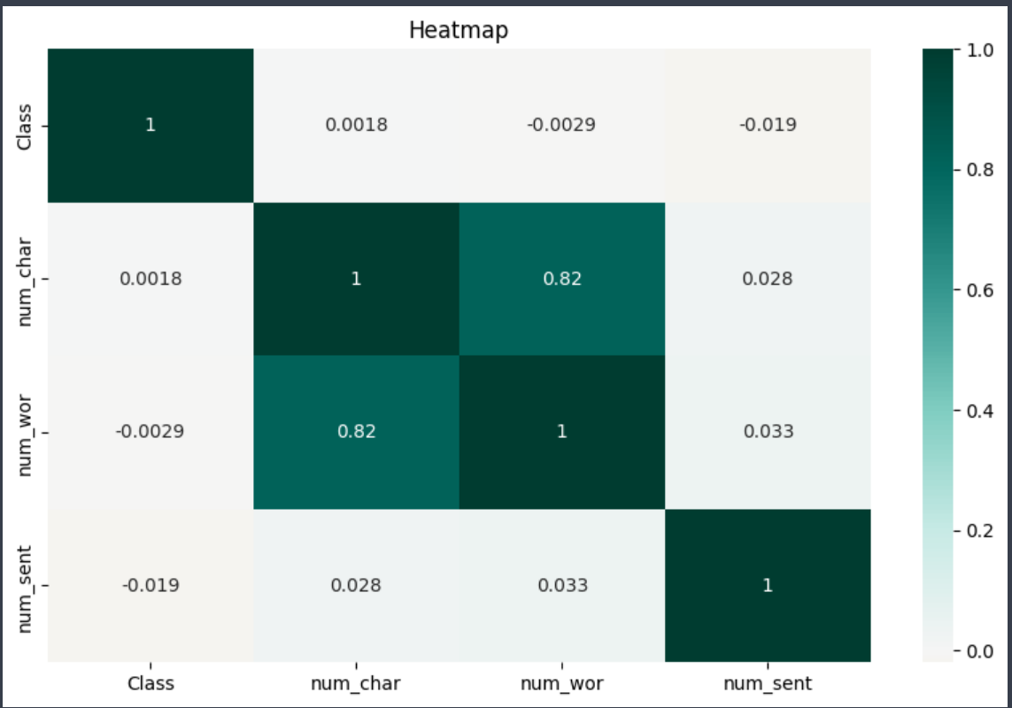
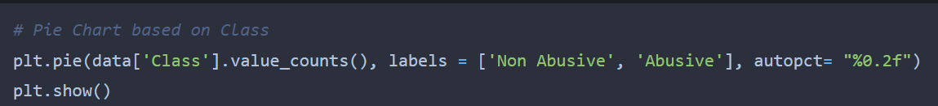
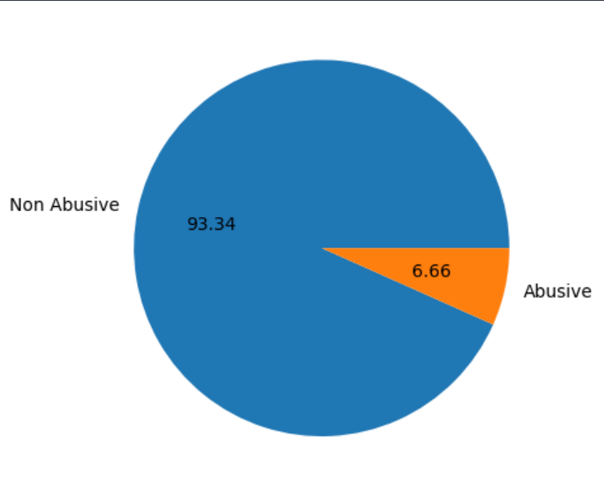
Pie Chart
Percentage of non-abusive and abusive words
Heat map
To find correlation btw class, num_char, num_word and num_sent

Slide 15
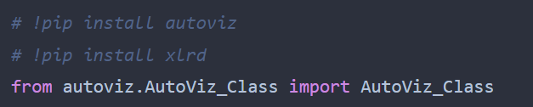
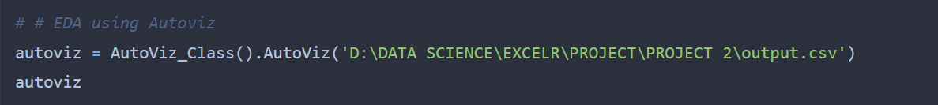
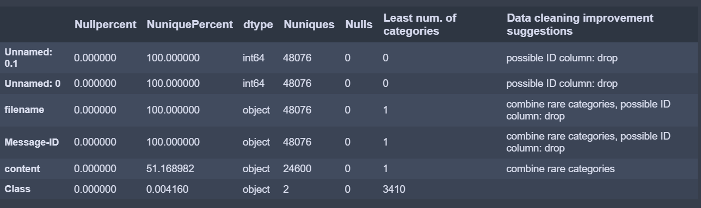
AUTO EDA – Method 1
Auto EDA done using AUTOVIZ Library
Automate the tasks of data preparation, cleaning, and analysis
The goal of Auto EDA is to streamline the data analysis process and reduce the time and effort required to perform exploratory data analysis

Slide 16
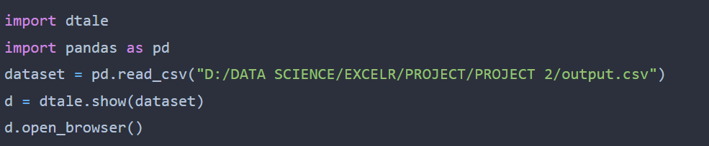
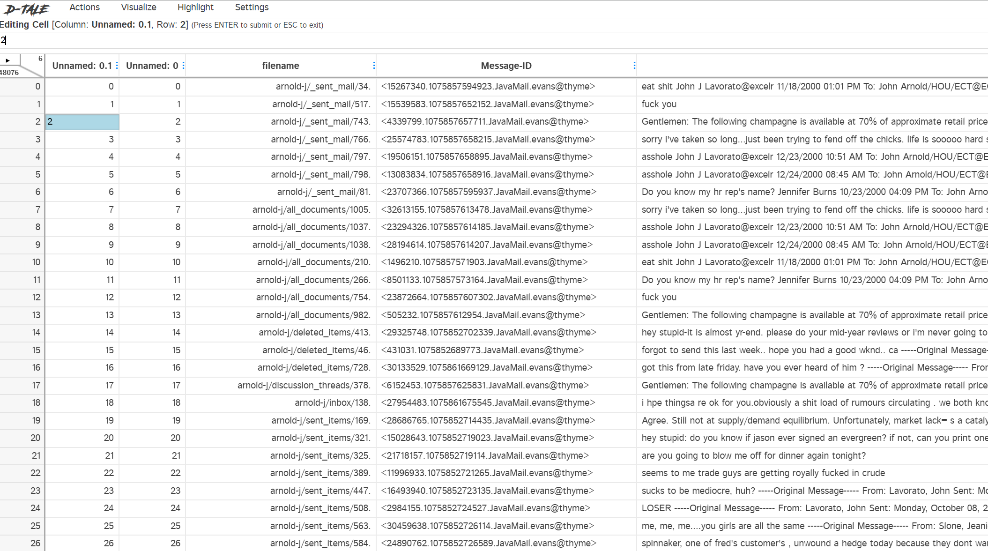
AUTO EDA – Method 2
Auto EDA done using dtale Library

Slide 17
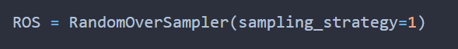
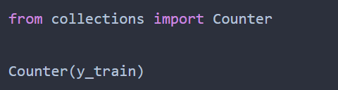
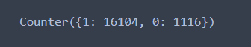
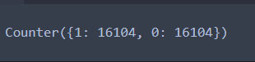
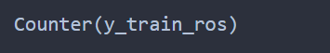
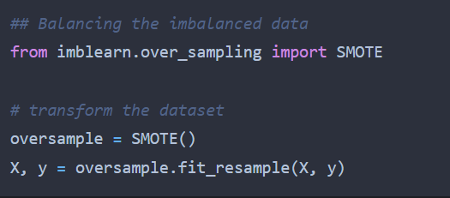
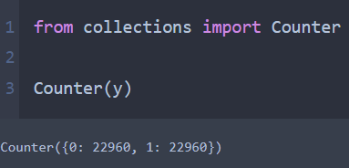
Balancing the data
Using Test train split and Random Over Sampling
y_train is the imbalanced data
y_train_ros is the balanced data
FOR MODEL BUILDING:
Used SMOTE for balancing the imbalanced data.

Slide 18
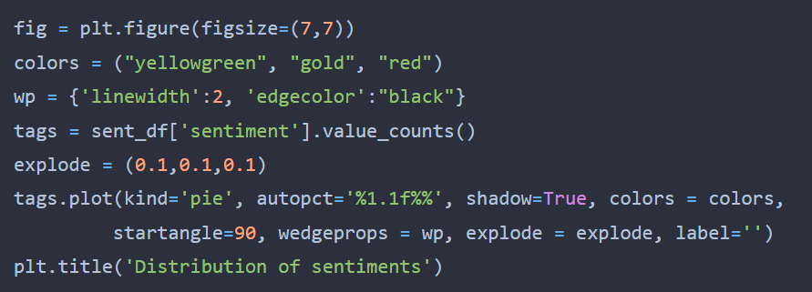
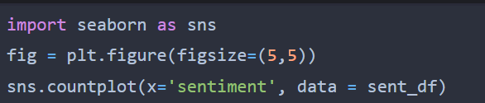
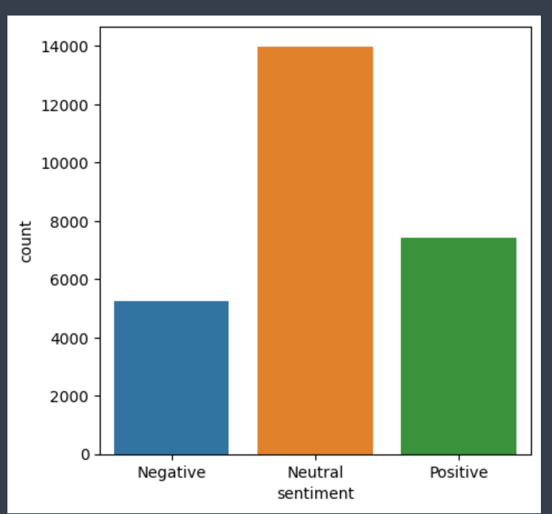
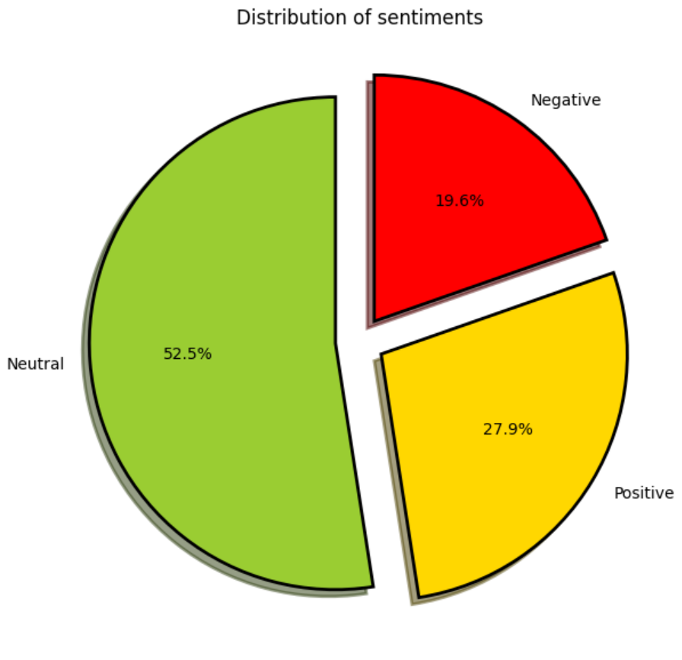
SENTIMENTAL ANALYSIS
Visualizing the negative, positive and neutral words in the given content using bar and pie charts

Slide 19
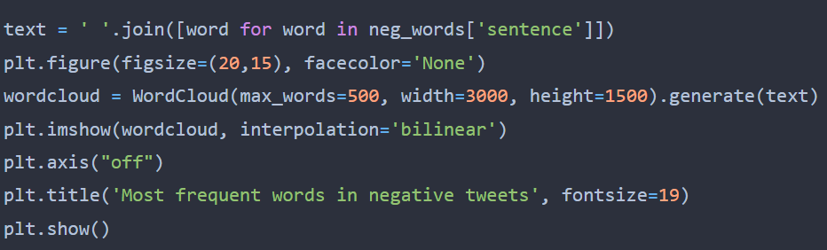
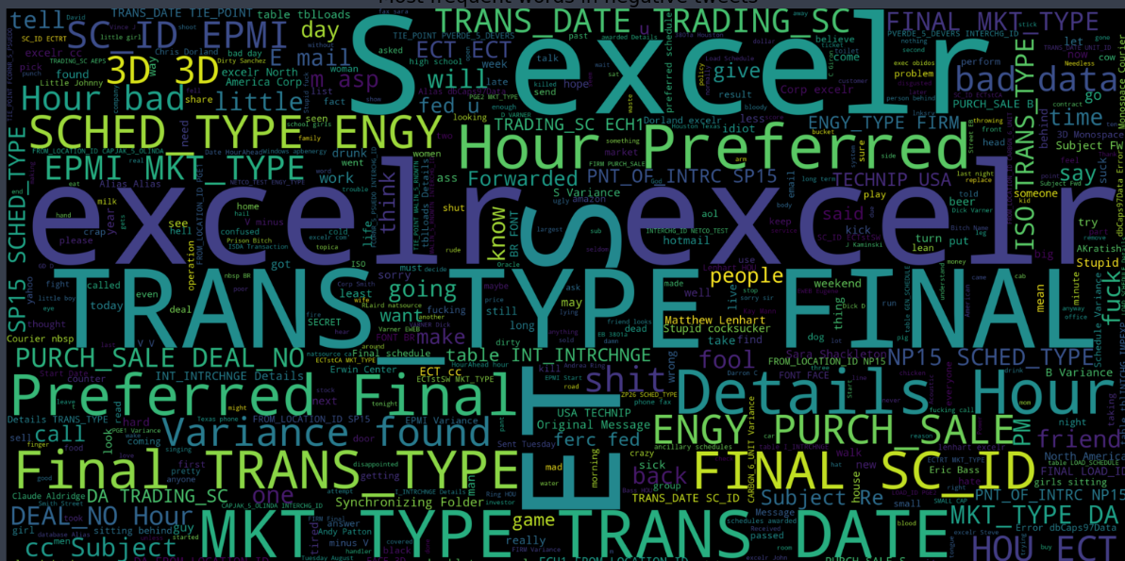
Negative word cloud

Slide 20
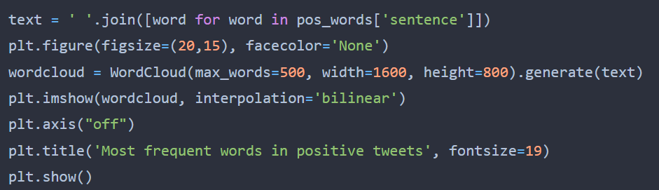
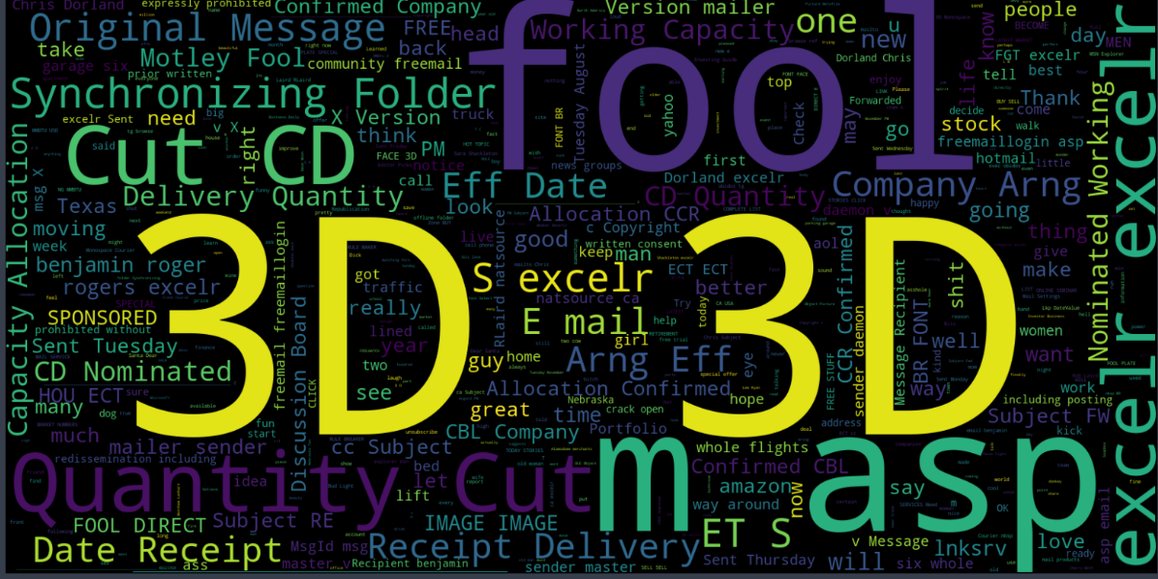
Positive word cloud

Slide 21
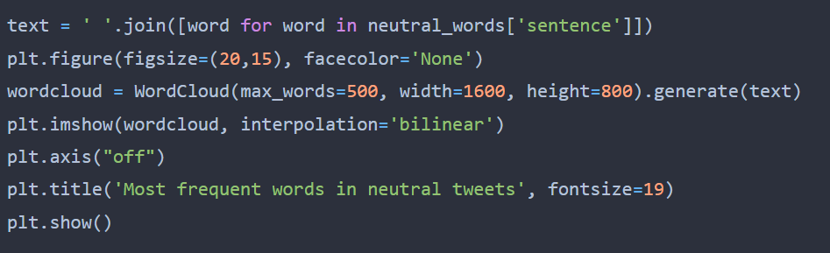
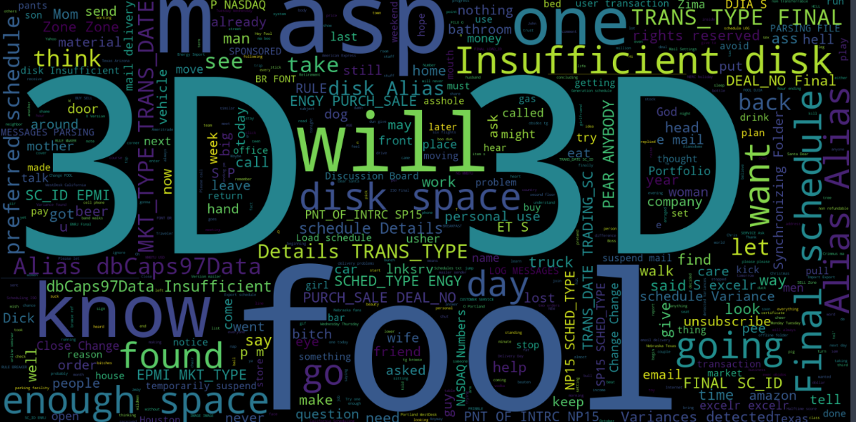
Neutral word cloud

Slide 22
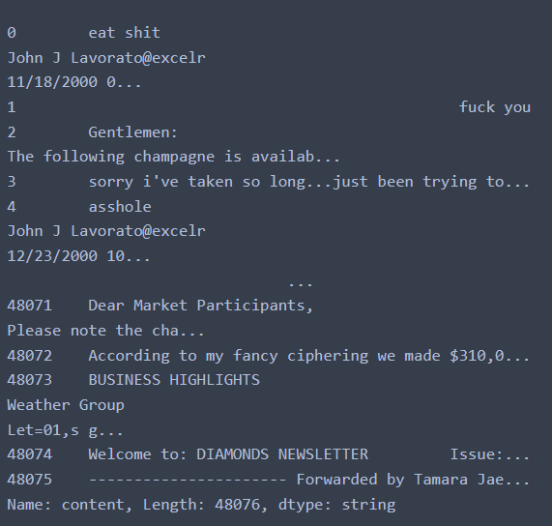
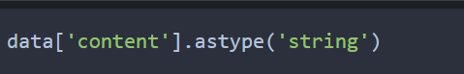


FEATURE EXTRACTION
For feature extraction, converted the content column datatype to string, for the ease.
Removing the special characters

Slide 23




Removing punctuations
Removing the extra spaces

Slide 24



Removing the digits
Tokenizing the words

Slide 25




Removing the stopwords from the dataset and printing the list of no stopwords
Normalizing the data
Stemming using nltk.stem library and PorterStemmer as it produces the best output and has less error rate. It helps in reducing the word length and creating a stem word which doesn’t exist in the library.

Slide 26




Joining all the no stop tokens
Lemmatization helps in reducing redundancy and get the valid words from WordNetLemmatizer from nltk.stem
CountVectorizer is used to convert a collection of text to a vector of token counts, enabling the ​pre-processing of text data prior to generating the vector representation

Slide 27




Printing the vectorizer vocabulary of the dataset
Extracting the tokens and the matrix using .toarray

Slide 28



Fitting the data using .fit_transform to produce a matrix
Extracting the features and converting it to matrix

Slide 29


TfidVectorizer(Term Frequency - Inverse Document Frequency) - uses the frequency of words to determine how relevant those words are to a given document and calculating the word frequency.

Slide 30





MODEL BUILDING
The classification algorithm used is- NAÏVE BAYES – Gaussian NB, Multinomial NB and XGBoost Classifier.
Predicting the result based on the test data of the independent variable.
Creating the confusion matrix using the dependent and the predicted value

Slide 31




For measuring the accuracy of the training and the test dataset
In the same way, built the model using Multinomial NB
The accuracy score matrix
The test and the train accuracy score

Slide 32







Using XGBOOST Classifier
Using Decision Tree Classifier
The confusion matrix and the accuracy

Slide 33




Using Random Forest Classifier

Slide 34




MODEL EVALUATION
The model evaluation techniques for the classification algorithm is available in the sklearn.metrics where area under the curve, f1 score, precision, recall, kappa score and support are calculated.
AUROC-
Accuracy under the receiver operating characteristic curve
AUPRC – Accuracy under the precision recall curve

Slide 35




Classification report- used to measure the quality of predictions from a classification algorithm
Calculated the kappa score

Slide 36



Model building using neural network: (CNN)
Step 1: Created the model, complied it and printed the summary
Step 2: Fitting the model
Step 3: Model Evaluation on the test data

Slide 37








Step 4: To predict the dependent variable from the independent test variable
Step 5: Using .flatten to get the float values
Step 6: Creating the confusion matrix and generating the accuracy score
The accuracy of CNN was found to be 96.57%

Slide 38



MODEL DEPLOYMENT
Imported pickle to dump the model. Created .sav file as this is a classification problem. And created the dump file of count vectorizer and stored them in the same file.
Downloaded the python file.py form
Ran the file in anaconda prompt using ‘streamlit run (filename).py’

Slide 39


Hence, by entering the content of the data, it will predict whether the content is abusive or non-abusive.

Slide 40


Model Deployment using CNN- NLP classified data
Dumped model using .h5 (this is specifically used for CNN)

